Slide 1

Analyzing NREGA: Insights for Effective Rural Employment
This project aims to analyze the data from India's National Rural Employment Guarantee Act (NREGA) program to evaluate its effectiveness, understand regional disparities, assess budget utilization, and identify key factors affecting program completion. By leveraging data analytics, the insights gained will guide policymakers in optimizing this crucial scheme for rural employment and development.

Slide 2
Evaluating NREGA's Effectiveness
Job Creation
Wage Disbursement
Asset Creation
The analysis will examine the number of job cards issued and person-days of employment generated under NREGA across different states and districts. This will help identify regions with high and low performance, allowing policymakers to target resource allocation and implement tailored interventions.
The timeliness and adequacy of wage payments to NREGA workers will be assessed, as prompt and sufficient wages are crucial for the program's success and worker satisfaction. Identifying bottlenecks in the wage disbursement process can inform process improvements.
The analysis will examine the types of assets created and their quality, as well as the completion rates of NREGA-funded projects. This will shed light on the program's ability to build valuable infrastructure and improve rural livelihoods.

Slide 3
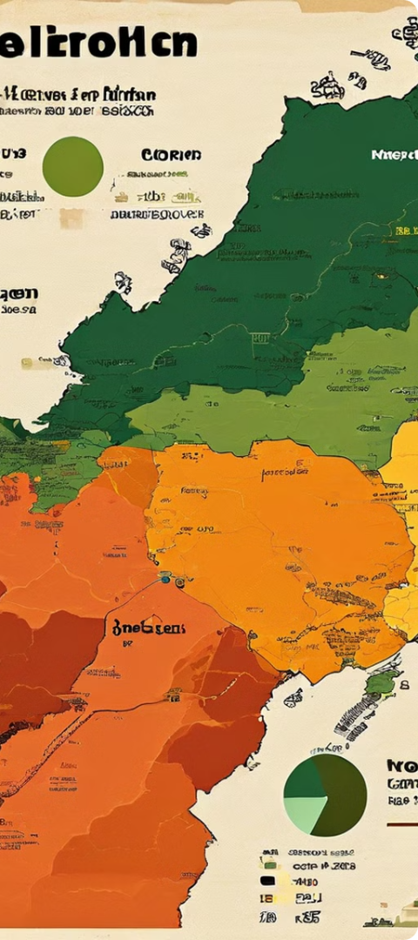
Understanding Regional Disparities
1
Geographical Variations
The analysis will explore the regional differences in NREGA performance, identifying states and districts that have consistently high or low outcomes. This will help policymakers understand the factors contributing to these disparities and develop targeted interventions.
2
Socioeconomic Factors
The study will investigate how socioeconomic indicators, such as poverty levels, literacy rates, and infrastructure development, influence NREGA's effectiveness across different regions. This will provide insights into the underlying drivers of the observed regional variations.
3
Demographic Dynamics
The analysis will also consider the role of demographic factors, such as the proportion of marginalized communities and the age distribution of the workforce, in shaping NREGA's performance in different areas. This will inform policymakers on how to better tailor the program to the unique needs of local populations.

Slide 4

Analyzing Budget Utilization
1
Budget Allocation
2
Expenditure Patterns
The analysis will examine the budgetary allocations for NREGA across different states and years, identifying patterns and trends in resource distribution. This will help assess the alignment between funding and actual program needs.
The study will delve into the expenditure patterns, including the timeliness and completeness of fund utilization. This will shed light on the efficiency of fund management and the factors influencing the effective deployment of NREGA resources.
3
Utilization Rates
The analysis will calculate the budget utilization rates for NREGA, both at the state and national levels. This will help identify regions with low utilization rates and understand the underlying reasons, informing strategies to improve fund absorption and program implementation.

Slide 5
Factors Affecting NREGA Completion
Infrastructure Availability
Administrative Capacity
The analysis will explore the relationship between the availability of critical infrastructure, such as access to roads, electricity, and communication networks, and the successful completion of NREGA projects. This will inform investments in rural infrastructure to support program implementation.
The study will assess the role of administrative efficiency, including the availability of skilled personnel, timely decision-making, and effective monitoring, in facilitating the timely completion of NREGA projects. This will help identify capacity-building needs for program management.
Community Engagement
Environmental Factors
The analysis will investigate the level of community participation and ownership in NREGA projects, as well as the impact of social mobilization efforts. This will provide insights into how to strengthen local-level engagement and enhance the sustainability of program outcomes.
The study will also consider the influence of environmental factors, such as climatic conditions and natural disasters, on the timely completion of NREGA projects. This will inform the development of climate-resilient strategies and disaster preparedness measures.

Slide 6



Insights for Policymakers
Targeted Interventions
Collaborative Approach
Evidence-based Policymaking
The insights from the data analysis will enable policymakers to design and implement targeted interventions to address regional disparities, improve budget utilization, and enhance the overall effectiveness of the NREGA program.
The study will foster collaboration between different government departments and stakeholders, ensuring a coordinated and comprehensive approach to optimizing the NREGA program for the benefit of rural communities.
By leveraging the data-driven insights, policymakers can make informed decisions and tailor the NREGA program to better meet the evolving needs of the rural workforce and align with broader development goals.

Slide 7



Skill Development for Participants
Data Preprocessing
Data Analysis
Policy Recommendations
Participants will gain expertise in data cleaning, transformation, and integration, essential for preparing the NREGA dataset for comprehensive analysis.
Participants will develop proficiency in applying advanced data analytics techniques, such as statistical modeling, trend analysis, and geospatial mapping, to uncover valuable insights from the NREGA data.
Participants will learn to translate data-driven insights into actionable policy recommendations, effectively communicating their findings to policymakers and stakeholders.

Slide 8

Conclusion
The NREGA analysis project offers a comprehensive and data-driven approach to evaluating the effectiveness of this crucial rural employment program. By delving into the nuances of job creation, wage disbursement, asset creation, regional disparities, budget utilization, and factors affecting program completion, the insights generated will empower policymakers to optimize the NREGA scheme and address the evolving needs of India's rural workforce. Participants in this project will gain invaluable skills in data preprocessing, analysis, and policymaking, equipping them to contribute to evidence-based decision-making and drive positive change in the rural development landscape.

